Slide 1

Java script
A história de um pinguim que quer virar programadora

Slide 2
Index:
Console
Comments
links

Slide 3
Console
In JS, refers to an object, a collection of data and actions, that we can use in our code.
One method that is built into the console object is the .log() method.
When we write console.log() what we put inside the parentheses will get printed or logged to the console.

Slide 4

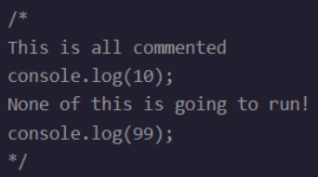

Comments
There are 2 type of code comments In JS:
A single line comment will comment out a single line and is denoted with forward slashes //.
You can also use a single line comment to comment after a line of code
A multi-line comment will comment out multiple lines and is denoted with /* to begin the comment and */ to end the comment
You can also use this syntax to comment something out in the middle of a line of code

Slide 5
Data types:
In JS there are 8 fundamental data types:
Number
Any number including number with decimals
BigInt
Any number greater than 2^53-1 or less than (2^53-1), with n appended to the number(123456n)
String
Any grouping of characters on your keyboard surrounded by quotes “ or ‘
Boolean
Only has 2 possible values: true or false
Null
Represents intentional absence of a value and is represented by the keyword null (without quotes)

Slide 6
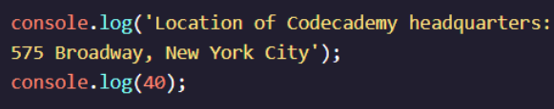
Undefined:
This data type is denoted by the keyword undefined (without quotes)
it also represents absence of a value though it has a different use than null.
it means that a given value does not exits
Symbol:
Unique identifiers
Object:
Collections of related data
In the code example, we first print a string. Our string isn’t just a single word, it includes both capital and lowercase letters, spaces and punctuation.
Next we printed the number 40 (without quotes)

Slide 7

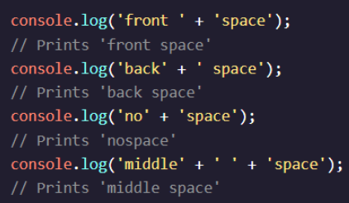
Arithmetic Operators
An operator is a character that performs a task in our code.
JS has several built-in arithmetic operators like:
Add +
Subtract –
Multiply *
Divide /
Remainder %
When we use the console.log() the computer will evaluate the expression inside the parentheses and print that result to the console..
If we wanted to print the characters 3+4 we should wrap the in quotes and print them as a string
The remainder operator or modulo returns the number that remains after the right-hand number divides into the left hand number as many times as it evenly can:
11 %3 = 2 as the remainder

Slide 8
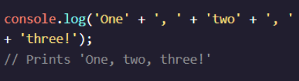
Just like in regular math, we can combine, or chain, our operations to get a final result

Slide 9
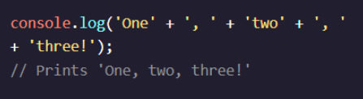
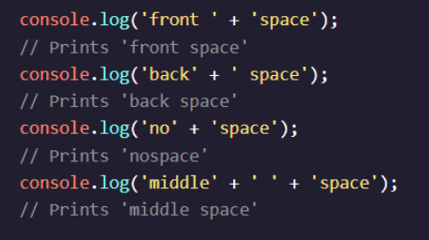
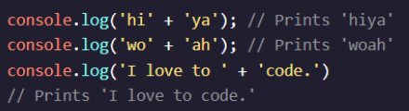
String concatenation
Operator aren’t just for numbers.
When a + operator is used on 2 strings, it appends the right string to the left string
This process of appending one string to another is called concatenation.
In the 3º example we had to make sure to include a space at the end of the first string.
We need to do this because the computer will join the strings exactly
Just like in regular math, we can combine, or chain, our operations to get a final result

Slide 10
Properties
When you introduce a new piece of data into a JS program, the browser saves it as an instance of the data type
All data types have access to specific properties that are passed down to each instance
FE: every string instance has a property called length that stores the number of characters in that string.
You can retrieve property info by appending the string with a period and the property name:
The . Is another operator! We call it the dot operator
In the code:
The value saved to length property is retrieved from the instance of the string ‘Hello’
The program print 5 to the console because hello has 5 characters in it

Slide 11
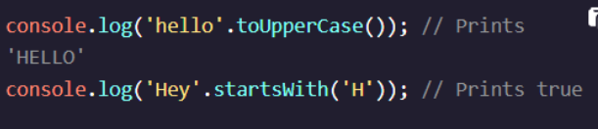
Methods
Methods are actions we can perform.
Data types have access to specific methods that allow us to handle instances of that data type.
We call, or use these methods by appending an instance with:
A period (the dot operator)
The name of the method
Opening and closing parentheses
F.E ‘example string’.methodName()
It’s similar to console.log() since we’re calling the .log() method on the console object.

Slide 12
Let’s examine the code.
On the first line, the .toUpperCase() method is called on the string instance ‘hello’.
The result is logged to the console.
This method returns a string in all capital letters: ‘HELLO’
On the second line, the .startsWith() methos is called on the string instance ‘Hey’
This method also accepts the character ‘H’ as an input or argument, between the parentheses.
Since the string ‘Hey’ does start with ‘H’, the method returns the Boolean true.

Slide 13


Built-in Objects
In addition to console, there are other objects built into JS.
If you wanted to perform more complex mathematical operations than arithmetic, JS has the built-in Math object.
The great thing about objects is that they have methodos!
Let’s call the .random() method from the built-in Math object (pic)
In this case:
Math.random() generates a random number between 0 and 1
We then multiply that number by 50, so we now have a number between 0 and 50
Then Math.floor() rounds the number down to the nearest whole number
If you wanted to see the number printed to the terminal, you would still need a console.log()

Slide 14

In the code example, we called the .random() method by appending the object name with the dot operator, the name of the method, and opening and closing parentheses
This returns a random number between 0 (inclusive) and 1 (exclusive)
To generate a random number between 0 and 50 we could multiply this by 50 like:
The example above will likely evaluate to a decimal.
To ensure the answer is a whole number, we can use the Math.floor() method.

Slide 15
Variables

Slide 16
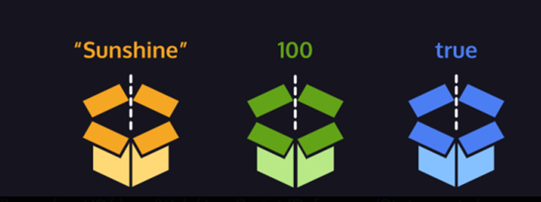
In programming, a variable is a container for a value
You can think of variable as little containers for info that live in a computer’s memory
Info stored in variables (such as username, acc number can then be found in memory)
Variables also provide a way of labelling data with a descriptive name, so our programs can be understood more clearly be the reader and ourselves
In short, variables label and store data in memory.
Things you can do with variables:
Create a variable with a descriptive name.
Store or update info stored in a variable
Reference or “get” info stored in a variable
Variables are NOT values
They contain values and represent them with a name
In the diagram, each box represent variables
The values are represented by the content and the name is represented with the label.

Slide 17

Var
In the example:
Var, short for variable, is a JS keyword that creates or declares a new variable.
myName is the variable’s name. Capitalizing in this way is a standard convention in JS called camel casing.
F.E: camelCaseEverythin
= is the assignment operator. It assigns the value ‘Arya’ to the variable myName.
‘Arya’ is the value assigned = to the variable myName. You can also say that the myName variable is initialized with a value of ‘Arya’
After the variable is declared, the string value ‘Arya’ is printed to the console by referencing the variable: console.log.(myName)

Slide 18
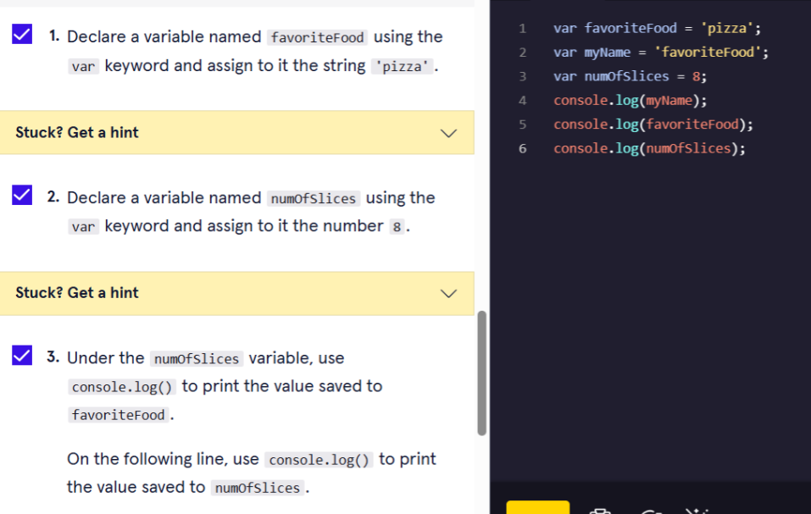
There are a few general rules for naming variables:
Variables names cannot start with numbers
Variables names are case sensitive. It is bad practice to create 2 variables that have the same name using different cases
Variables names cannot be the same as keywords.
Let and const are the preferred variable keywords by many programmers

Slide 19
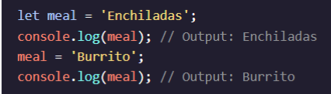
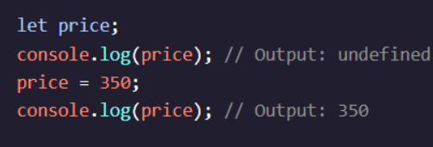
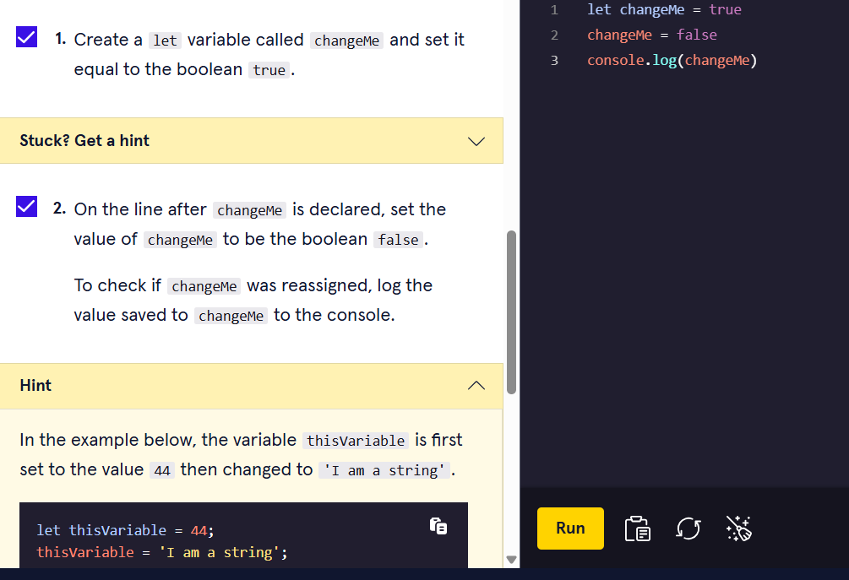
Let
The let keyword signal that the variable can be reassigned a different value.
Another concept that we should be aware of when using let or var Is that we can declare a variable without assigning the variable a value
In this case, the variable will be automatically initialized with a value of undefined (image 2)
In the 2º code.
If we don’t assign a value to a variable declared using the let keyword, it automatically has a value of undefined
We can reassign the value of the variable

Slide 20

Const
Just like with var and let you can store any value in const variable.
The way you declare a const variable and assign a value to it follows the same structure as let and var.
A const variable cannot be reassigned because it is a constant.
If you try you’ll get a TypeError
Constant variable must be assigned a value when declared.
if you try to declare a const variable without a value you’ll get a SyntaxError.
If you’re trying to decide between which keyword to use (let or const), think about whether you’ll need to reassign the variable later on.
If you’ll need to, just use let.

Slide 21
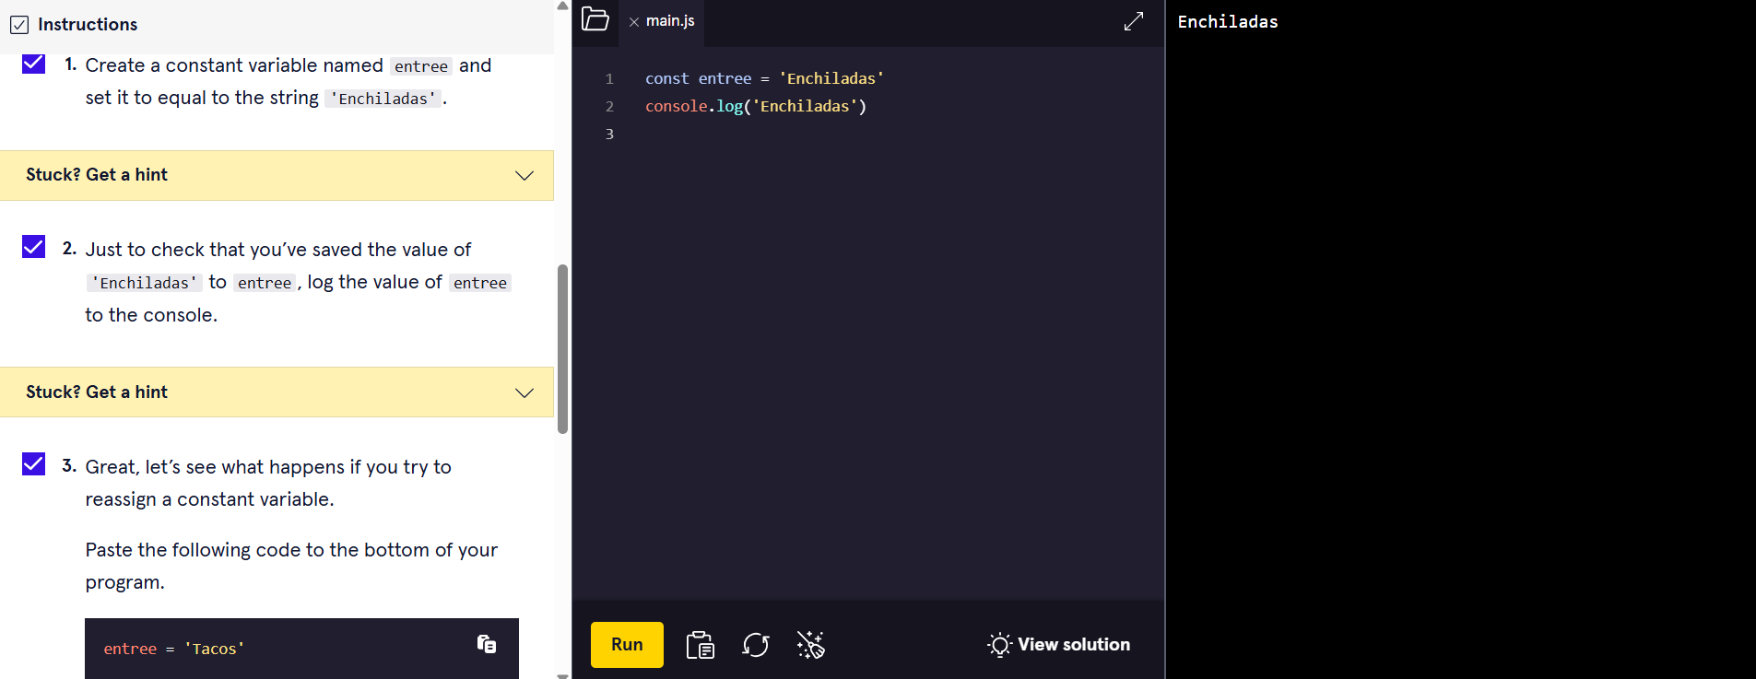
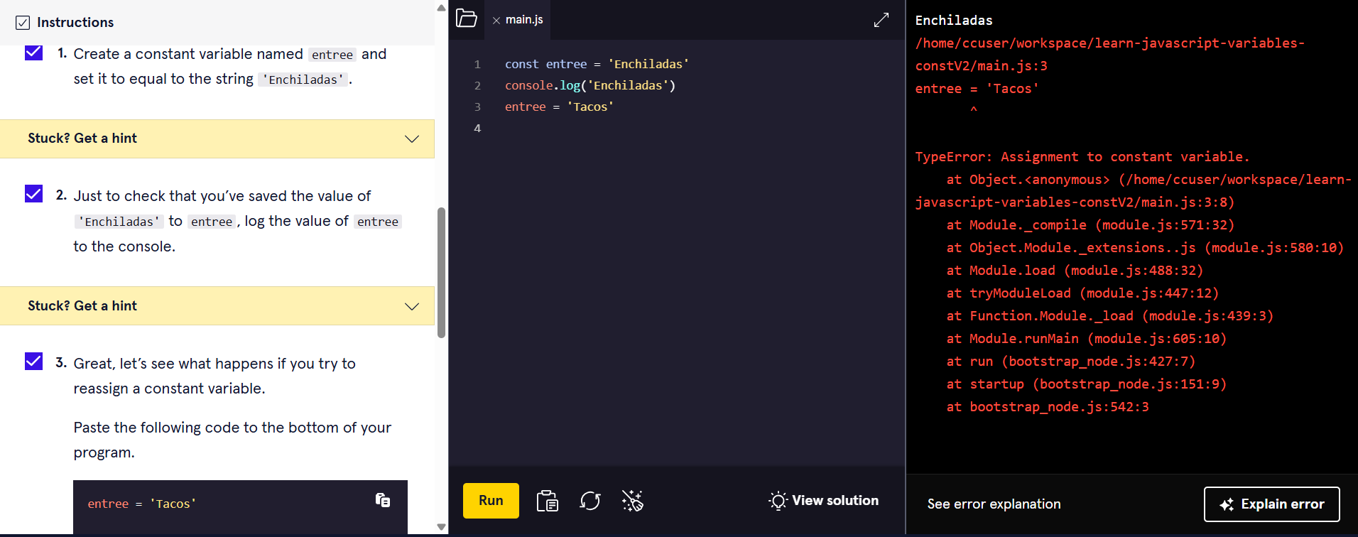

Slide 22
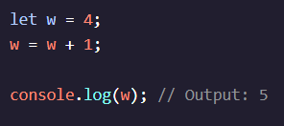
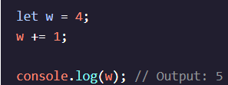
Mathematical Assignment Operators
In the example, we created the variable w with the number 4 assigned to it.
The following line, w=w+1, increases the value of w from 4 to 5
Another way we could have reassigned w after performing some math operation on it is to use built-in mathematical assignment operators.
We could re-write the code above:
In the 2º ex we used the += assignment operator to reassign w.
We’re performing the mathematical operation of the first operator + using the number to the right then reassigning w to the computed value.

Slide 23
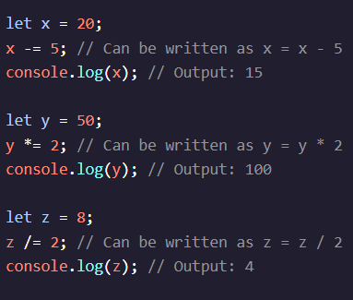
We also have access to other mathematical assignment operators:
-=
*=
/=
Which work in a similar fashion

Slide 24
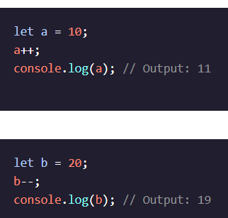
The Increment and Decrement Operator
other mathematical assignment operator include the increment operator ++ and decrement operator –
The increment operator will increase the value of the variable by 1
The decrement operator will decrease the value of the variable by 1
Just like the previous mathematical assignment operators (+=, -=, *=, /=) the variable’s value is updated and assigned as the new value of the variable.

Slide 25


String Concatenation with Variables
In the previous exercises we assigned strings to variables, lets now see how to connect or concatenate strings in variables.
The + operator can be used to combine 2 string values even if those values are being stored in variables:
In the example we assigned the value ‘armadillo’ to the myPet variable.
On the 2º line, the + operator is used to combine 3 strings:
‘I own a pet’
myPet
‘.’
We log the result of this concatenation as:

Slide 26
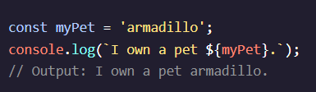
String Interpolation
We can insert or interpolate, variables into string using template literals.
Notice that:
A template literal is wrapped by backticks `
Inside the template literal, you’ll see a placeholder, ${myPet}. The value of myPet is inserted into the template literal
When we interpolate `I own a pet ${myPet}.`the output we print is the tring: ‘I own a pet armadillo.’
One of the biggest benefits to using template literals is the readability of the code.
Using template literals, you can more easily tell what the new string will be.
You also don’t have to worry about escaping double quotes or single quotes

Slide 27
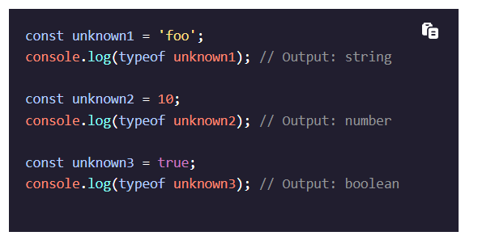
Typeof operator
While coding, it can be useful to keep track of the data types of the variables in your program.
If you need to check data type of variable’s value, you can use the typeof operator
The typeof operator checks the value to its right and returns, or passes back, a string of the data type.
Let’s break down the example.
Since the value unkown1 is ‘foo’, a string, typeof unknnow1 will return ‘string’

Slide 28
Conditional Statements

Slide 29
What are Conditional Statements
If we are tired, we go to bed, otherwise, we wake up and start our day
These if-else decision can be modelled in code by creating conditional statements.
A conditional statement checks a specific condition(s) and performs a task bases on the condition(s)
We will be covering:
If, else if, else
Comparison operators
Logical operators
Truthy vs falsy values
Ternary operators
Switch statement

Slide 30
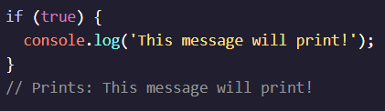
If statement
We often perform a task based on a condition
F.E. if the weather is nice, we will go outside
In programming, we can also perform a task based on a condition using an if statement
In the example, we have an if statement and it’s composed of:
The if keyword followed by a set of () which is followed by a code block or block statement, indicated by a set of curly braces {}
Inside the parentheses () a condition is provided that evaluates to true or false
If the condition evaluates to true, the code inside the curly braces{} runs or executes
If the condition evaluates to false, the block won’t execute

Slide 31
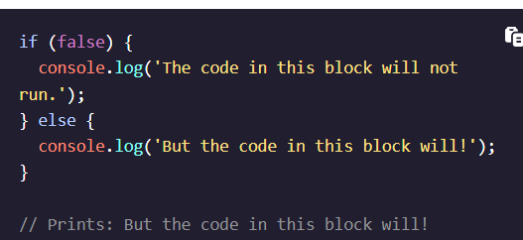
If… Else statements
In many cases, we’ll have code we want to run if our condition evaluates to false.
If we want to add some default behaviour to the if statement, we can add an else statement to run a block of code when the condition evaluates to false
An else statement must be paired with an if statement, and together they are referred to as an if…else statement
In the example:
Uses the else keyword following the code block of an if statement
Has a code block that is wrapped by a set of curly braces {}
The code inside the else statement code block will execute when the if statement’s condition evaluates to false
If…else statements allow us to automate solutions to yes or no questions also knows as binary decisions

Slide 32

Comparison Operators
When writing conditional statements, sometimes we need to use different types of operators to compare values.
These operators are called comparison operators.
Here is a list of some handy comparison operators and their syntax:
Less than: <
Greater than: >
Less than or equal to: <=
Greater than or equal to: >=
Is equal to: ===
Is not equal to: !==
Comparison operators compare the value on the left with the value on the right. For instance:

Slide 33

It can be helpful to think of comparison statements as questions.
When the answer is “yes”, the statement evaluates to true, and when the answer is “no”, the statement evaluates to false.
The code would be asking: is 10 less than 12? Yes! So 10 < 12 evaluates to true.
We can also use comparison operators on different data types like strings:
In the example, we’re using the identity operator (===) to check if the string 'apples' is the same as the string 'oranges’.
Since the two strings are not the same, the comparison statement evaluates to false.
All comparison statements evaluate to either true or false and are made up of:
Two values that will be compared.
An operator that separates the values and compares them accordingly (>, <, <=,>=,===,!==).

Slide 34
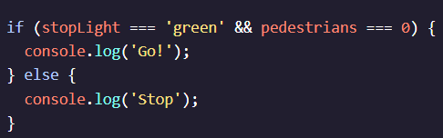
Logical operators
Working with conditionals means that we will be using booleans, true or false values.
In JavaScript, there are operators that work with boolean values known as logical operators.
We can use logical operators to add more sophisticated logic to our conditionals.
There are three logical operators:
the and operator (&&)
the or operator (||)
the not operator, otherwise known as the bang operator (!)
When we use the && operator, we are checking that two things are true:

Slide 35
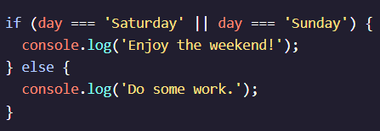
When using the && operator, both conditions must evaluate to true for the entire condition to evaluate to true and execute.
Otherwise, if either condition is false, the && condition will evaluate to false and the else block will execute.
If we only care about either condition being true, we can use the || operator:
When using the || operator, only one of the conditions must evaluate to true for the overall statement to evaluate to true.
In the code example above, if either day === 'Saturday' or day === 'Sunday' evaluates to true the if‘s condition will evaluate to true and its code block will execute.
If the first condition in an || statement evaluates to true, the second condition won’t even be checked.
Only if day === 'Saturday' evaluates to false will day === 'Sunday' be evaluated.
The code in the else statement will execute only if both comparisons evaluate to false.

Slide 36
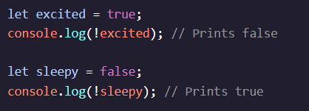
The ! not operator reverses, or negates, the value of a boolean:
Essentially, the ! operator will either take a true value and pass back false, or it will take a false value and pass back true.
Logical operators are often used in conditional statements to add another layer of logic to our code.

Slide 37
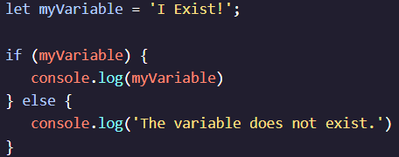
Truthy and Falsy
Let’s consider how non-boolean data types, like strings or numbers, are evaluated when checked inside a condition.
Sometimes, you’ll want to check if a variable exists and you won’t necessarily want it to equal a specific value — you’ll only check to see if the variable has been assigned a value.
The code block in the if statement will run because myVariable has a truthy value; even though the value of myVariable is not explicitly the value true, when used in a boolean or conditional context, it evaluates to true because it has been assigned a non-falsy value.

Slide 38
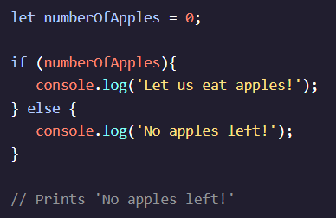
So which values are falsy— or evaluate to false when checked as a condition? The list of falsy values includes:
0
Empty strings like "" or ''
null which represent when there is no value at all
undefined which represent when a declared variable lacks a value
NaN, or Not a Number
The condition evaluates to false because the value of the numberOfApples is 0.
Since 0 is a falsy value, the code block in the else statement will run.

Slide 39
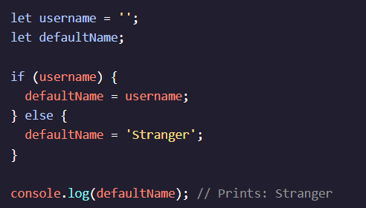
Truthy and Falsy assignment
Truthy and falsy evaluations open a world of short-hand possibilities!
Say you have a website and want to take a user’s username to make a personalized greeting.
Sometimes, the user does not have an account, making the username variable falsy.
The code checks if username is defined and assigns a default string if it is not:

Slide 40
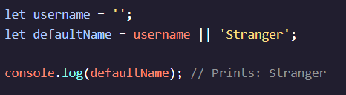
If you combine your knowledge of logical operators you can use a short-hand for the code above.
In a boolean condition, JavaScript assigns the truthy value to a variable if you use the || operator in your assignment:
Because || or statements check the left-hand condition first, the variable defaultName will be assigned the actual value of username if it is truthy, and it will be assigned the value of 'Stranger' if username is falsy.
This concept is also referred to as short-circuit evaluation.

Slide 41
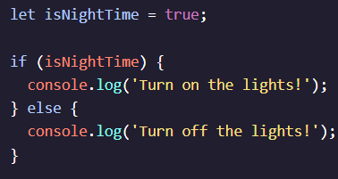

Ternary Operator
In the spirit of using short-hand syntax, we can use a ternary operator to simplify an if...else statement.
Take a look at the if...else statement example:
We can use a ternary operator to perform the same functionality:

Slide 42
In the example
The condition, isNightTime, is provided before the ?.
Two expressions follow the ? and are separated by a colon :.
If the condition evaluates to true, the first expression executes.
If the condition evaluates to false, the second expression executes.
Like if...else statements, ternary operators can be used for conditions which evaluate to true or false.

Slide 43
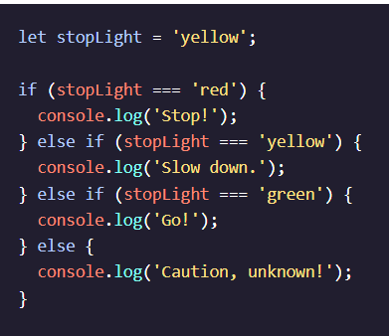
Else If Statements
We can add more conditions to our if...else with an else if statement
The else if statement allows for more than two possible outcomes.
You can add as many else if statements as you’d like, to make more complex conditionals!
The else if statement always comes after the if statement and before the else statement.
The else if statement also takes a condition.

Slide 44
The else if statements allow you to have multiple possible outcomes.
if/else if/else statements are read from top to bottom, so the first condition that evaluates to true from the top to bottom is the block that gets executed.
In the example, since stopLight === 'red' evaluates to false and stopLight === 'yellow' evaluates to true, the code inside the first else if statement is executed.
The rest of the conditions are not evaluated.
If none of the conditions evaluated to true, then the code in the else statement would have executed.

Slide 45
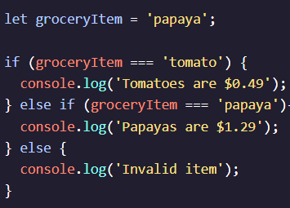
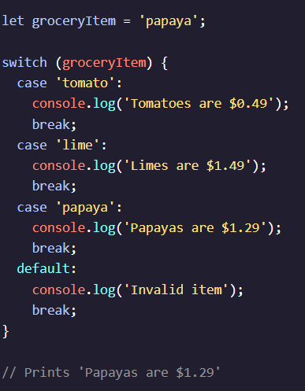
The switch keyword
else if statements are a great tool if we need to check multiple conditions.
In programming, we often find ourselves needing to check multiple values and handling each of them differently. For example:
In the code, we have a series of conditions checking for a value that matches a groceryItem variable. Our code works fine but imagine if we needed to check 100 different values! Having to write that many else if statements sounds like a pain!
A switch statement provides an alternative syntax that is easier to read and write.
A switch statement looks like this:

Slide 46
The switch keyword initiates the statement and is followed by, which contains the value that each case will compare.
In the example, the value or expression of the switch statement is groceryItem.
Inside the block, { ... }, there are multiple cases.
The case keyword checks if the expression matches the specified value that comes after it.
The value following the first case is 'tomato'. If the value of groceryItem equalled 'tomato', that case‘s console.log() would run.
The value of groceryItem is 'papaya', so the third case runs— Papayas are $1.29 is logged to the console.
The break keyword tells the computer to exit the block and not execute any more code or check any other cases inside the code block.
Note: Without break keywords, the first matching case will run, but so will every subsequent case regardless of whether or not it matches—including the default.
This behavior is different from if/else conditional statements that execute only one block of code.
At the end of each switch statement, there is a default statement. If none of the cases are true, then the code in the default statement will run

Slide 47
functions

Slide 48
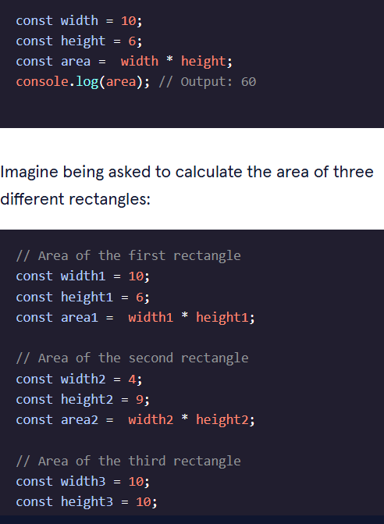
What are functions
A function is a reusable block of code that groups together a sequence of statements to perform a specific task.

Slide 49
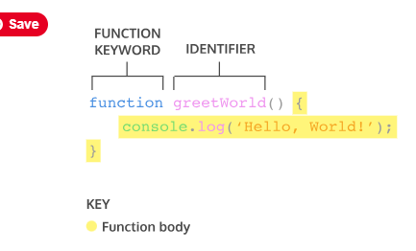
Function declarations
In JavaScript, there are many ways to create a function
One way to create a function is by using a function declaration.
Just like how a variable declaration binds a value to a variable name, a function declaration binds a function to a name, or an identifier.
Take a look at the anatomy of a function declaration
A function declaration consists of:
The function keyword.
The name of the function, or its identifier, followed by parentheses.
A function body, or the block of statements required to perform a specific task, enclosed in the function’s curly brackets, { }.

Slide 50
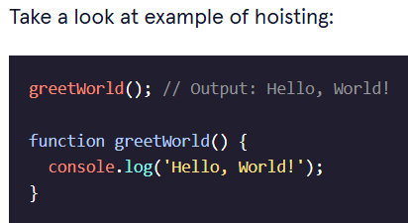
A function declaration is a function that is bound to an identifier, or name.
We should also be aware of the hoisting feature in JavaScript which allows access to function declarations before they’re defined.
Notice how hoisting allowed greetWorld() to be called before the greetWorld() function was defined!
Since hoisting isn’t considered good practice, we simply want you to be aware of this feature.
.

Slide 51

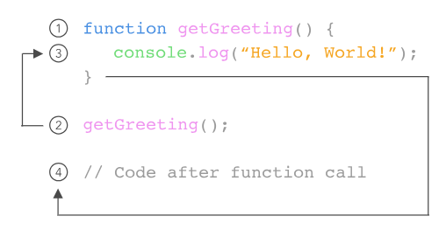
Calling a function
As we saw in previous exercises, a function declaration binds a function to an identifier.
However, a function declaration does not ask the code inside the function body to run, it just declares the existence of the function.
The code inside a function body runs, or executes, only when the function is called.
To call a function in your code, you type the function name followed by parentheses.
This function call executes the function body, or all of the statements between the curly braces in the function declaration.
We can call the same function as many times as needed.

Slide 52
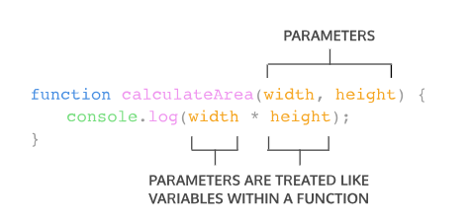
Parameters and Arguments
Some functions can take inputs and use the inputs to perform a task.
When declaring a function, we can specify its parameters.
Parameters allow functions to accept input(s) and perform a task using the input(s).
We use parameters as placeholders for information that will be passed to the function when it is called.
Let’s observe how to specify parameters in our function declaration

Slide 53
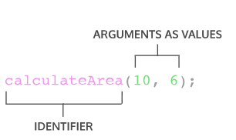
In the diagram, calculateArea(), computes the area of a rectangle, based on two inputs, width and height.
The parameters are specified between the parenthesis as width and height, and inside the function body, they act just like regular variables . width and height act as placeholders for values that will be multiplied together.
When calling a function that has parameters, we specify the values in the parentheses that follow the function name.
The values that are passed to the function when it is called are called arguments. Arguments can be passed to the function as values or variables.

Slide 54
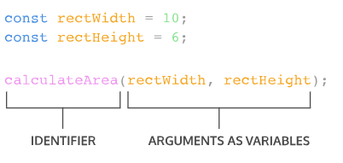
In the function call, the number 10 is passed as the width and 6 is passed as height.
Notice that the order in which arguments are passed and assigned follows the order that the parameters are declared.
The variables rectWidth and rectHeight are initialized with the values for the height and width of a rectangle before being used in the function call.
By using parameters, calculateArea() can be reused to compute the area of any rectangle!

Slide 55
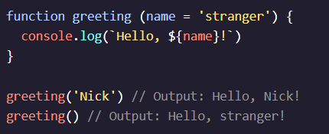
Default parameters
Default parameters allow parameters to have a predetermined value in case there is no argument passed into the function or if the argument is undefined when called.
Take a look at the code snippet below that uses a default parameter
In the example, we used the = operator to assign the parameter name a default value of 'stranger’.
This is useful to have in case we ever want to include a non-personalized default greeting!
When the code calls greeting('Nick') the value of the argument is passed in and, 'Nick', will override the default parameter of 'stranger' to log 'Hello, Nick!' to the console.
When there isn’t an argument passed into greeting(), the default value of 'stranger' is used, and 'Hello, stranger!' is logged to the console.
By using a default parameter, we account for situations when an argument isn’t passed into

Slide 56
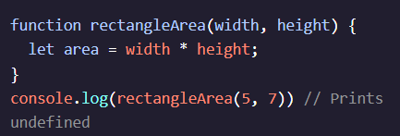
Return
When a function is called, the computer will run through the function’s code and evaluate the result.
By default, the resulting value is undefined.
In the code example:
We defined our function to calculate the area of a width and height parameter.
Then rectangleArea() is invoked with the arguments 5 and 7.
But when we went to print the results we got undefined.
Did we write our function wrong?
No! In fact, the function worked fine, and the computer did calculate the area as 35, but we didn’t capture it. So how can we do that? With the keyword return!

Slide 57
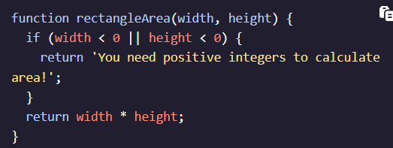
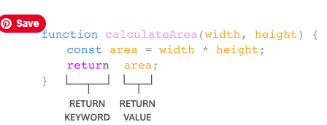
To pass back information from the function call, we use a return statement
To create a return statement, we use the return keyword followed by the value that we wish to return.
Like we saw above, if the value is omitted, undefined is returned instead.
When a return statement is used in a function body, the execution of the function is stopped and the code that follows it will not be executed.
If an argument for width or height is less than 0, then rectangleArea() will return 'You need positive integers to calculate area!’.
The second return statement width * height will not run.
The return keyword is powerful because it allows functions to produce an output. We can then save the output to a variable for later use.

Slide 58
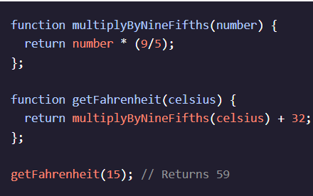
Helper functions
We can also use the return value of a function inside another function. These functions being called within another function are often referred to as helper functions.
Since each function is carrying out a specific task, it makes our code easier to read and debug if necessary.
If we wanted to define a function that converts the temperature from Celsius to Fahrenheit, we could write two functions like:

Slide 59
In the example above:
getFahrenheit() is called and 15 is passed as an argument.
The code block inside of getFahrenheit() calls multiplyByNineFifths() and passes 15 as an argument.
multiplyByNineFifths() takes the argument of 15 for the number parameter.
The code block inside of multiplyByNineFifths() function multiplies 15 by (9/5), which evaluates to 27.
27 is returned back to the function call in getFahrenheit().
getFahrenheit() continues to execute. It adds 32 to 27, which evaluates to 59.
Finally, 59 is returned back to the function call getFahrenheit(15).
We can use functions to section off small bits of logic or tasks, then use them when we need to.
Writing helper functions can help take large and difficult tasks and break them into smaller and more manageable tasks.

Slide 60
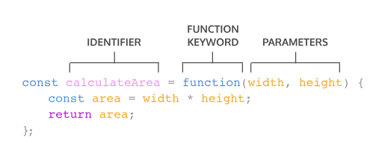
Function Expressions
Another way to define a function is to use a function expression.
To define a function inside an expression, we can use the function keyword.
In a function expression, the function name is usually omitted.
A function with no name is called an anonymous function.
A function expression is often stored in a variable in order to refer to it.

Slide 61

To declare a function expression:
Declare a variable to make the variable’s name be the name, or identifier, of your function.
It is common practice to use const as the keyword to declare the variable.
Assign as that variable’s value an anonymous function created by using the function keyword followed by a set of parentheses with possible parameters.
Then a set of curly braces that contain the function body.
To invoke a function expression, write the name of the variable in which the function is stored followed by parentheses enclosing any arguments being passed into the function.
Unlike function declarations, function expressions are not hoisted so they cannot be called before they are defined.

Slide 62
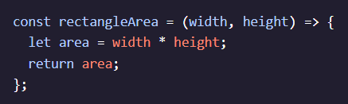
Arrow Functions
A shorter way to write functions by using the special “fat arrow” () => notation.
Arrow functions remove the need to type out the keyword function every time you need to create a function.
Instead, you first include the parameters inside the ( ) and then add an arrow => that points to the function body surrounded in { } like this
It’s important to be familiar with the multiple ways of writing functions because you will come across each of these when reading other JavaScript code.

Slide 63
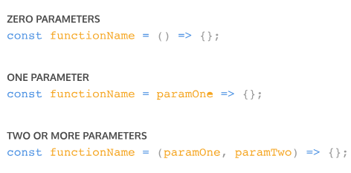
Concise Body Arrow Functions
JavaScript also provides several ways to refactor arrow function syntax.
The most condensed form of the function is known as concise body.
We’ll explore a few of these techniques below:
Functions that take only a single parameter do not need that parameter to be enclosed in parentheses. However, if a function takes zero or multiple parameters, parentheses are required.

Slide 64
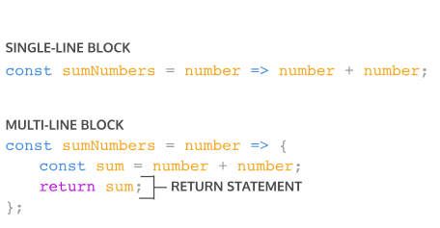

A function body composed of a single-line block does not need curly braces.
Without the curly braces, whatever that line evaluates will be automatically returned.
The contents of the block should immediately follow the arrow => and the return keyword can be removed. This is referred to as implicit return.
Notice the following changes:
The parentheses around num have been removed, since it has a single parameter.
The curly braces { } have been removed since the function consists of a single-line block.
The return keyword has been removed since the function consists of a single-line block.

Slide 65
scope

Slide 66
Scope
An important idea in programming is scope.
Scope defines where variables can be accessed or referenced.
While some variables can be accessed from anywhere within a program, other variables may only be available in a specific context.
You can think of scope like the view of the night sky from your window
Everyone who lives on the planet Earth is in the global scope of the stars.
The stars are accessible globally.
Meanwhile, if you live in a city, you may see the city skyline or the river.
The skyline and river are only accessible locally in your city, but you can still see the stars that are available globally.

Slide 67


Blocks and Scope
We’ve seen blocks used before in functions and if statements
A block is the code found inside a set of curly braces {}.
Blocks help us group one or more statements together and serve as an important structural marker for our code.
A block of code could be a function (pic 1)
Notice that the function body is actually a block of code.
Observe the block in an if statement (pic 2)

Slide 68

Global Scope
Scope is the context in which our variables are declared.
We think about scope in relation to blocks because variables can exist either outside of or within these blocks.
In global scope, variables are declared outside of blocks.
These variables are called global variables.
Because global variables are not bound inside a block, they can be accessed by any code in the program, including code in blocks.
Let’s take a look at an example of global scope:
Even though the color variable is defined outside of the block, it can be accessed in the function block, giving it global scope.
In turn, color can be accessed within the returnSkyColor function block.

Slide 69

Block Scope
When a variable is defined inside a block, it is only accessible to the code within the curly braces {}.
We say that variable has block scope because it is only accessible to the lines of code within that block.
Variables that are declared with block scope are known as local variables because they are only available to the code that is part of the same block.
Block scope works like this
You’ll notice:
We define a function logSkyColor().
Within the function, the color variable is only available within the curly braces of the function.
If we try to log the same variable outside the function, it throws a ReferenceError.

Slide 70
Scope Pollution
Having too many global variables can cause problems in a program.
When you declare global variables, they go to the global namespace.
The global namespace allows the variables to be accessible from anywhere in the program.
These variables remain there until the program finishes which means our global namespace can fill up really quickly.
Scope pollution is when we have too many global variables that exist in the global namespace, or when we reuse variables across different scopes.
Scope pollution makes it difficult to keep track of our different variables and sets us up for potential accidents.
For example, globally scoped variables can collide with other variables that are more locally scoped, causing unexpected behavior in our code.

Slide 71

You’ll notice:
We have a variable num.
Inside the function body of logNum(), we want to declare a new variable but forgot to use the let keyword.
When we call logNum(), num gets reassigned to 100.
The reassignment inside logNum() affects the global variable num.
Even though the reassignment is allowed and we won’t get an error, if we decided to use num later, we’ll unknowingly use the new value of num.
While it’s important to know what global scope is, it’s best practice to not define variables in the global scope.

Slide 72

Practice Good Scoping
Given the challenges with global variables and scope pollution, we should follow best practices for scoping our variables as tightly as possible using block scope.
Tightly scoping your variables will greatly improve your code in several ways:
It will make your code more legible since the blocks will organize your code into discrete sections.
It makes your code more understandable since it clarifies which variables are associated with different parts of the program rather than having to keep track of them line after line!
It’s easier to maintain your code, since your code will be modular.
It will save memory in your code because it will cease to exist after the block finishes running.

Slide 73
Here, you’ll notice:
We create a variable color inside the logSkyColor() function.
After the if statement, we define a new code block with the {} braces.
´Here we assign a new value to the variable color if the if statement is truthy.
Within the if block, the color variable holds the value 'pink', though outside the if block, in the function body, the color variable holds the value 'blue'.
On the last line, we attempt to print the value of color outside both the if statement and the definition of logSkyColor().
This will throw a ReferenceError since color only exists within the scope of those two blocks — it is never defined in the global scope.
While we use block scope, we still pollute our namespace by reusing the same variable name twice.
A better practice would be to rename the variable inside the block.
Block scope is a powerful tool in JavaScript, since it allows us to define variables with precision, and not pollute the global namespace.
If a variable does not need to exist outside a block— it shouldn’t!

Slide 74
Arrays

Slide 75

Create an Array
One way we can create an array is to use an array literal. An array literal creates an array by wrapping items in square brackets [].
Remember from the previous exercise, arrays can store any data type — we can have an array that holds all the same data types or an array that holds different data types.

Slide 76


Arrays
Organizing and storing data is a foundational concept of programming.
One way we organize data in real life is by making lists.
Let’s make one here
Arrays are JavaScript’s way of making lists.
Arrays can store any data types (including strings numbers, and booleans).
Like lists, arrays are ordered, meaning each item has a numbered position.
Here’s an array of the concepts we’ll cover:

Slide 77

Let’s take a closer look at the syntax in the array example:
The array is represented by the square brackets [] and the content inside.
Each content item inside an array is called an element.
There are three different elements inside the array.
Each element inside the array is a different data type.
We can also save an array to a variable.
You may have noticed we did this in the previous exercise:

Slide 78

Accessing Elements
Each element in an array has a numbered position known as its index.
We can access individual items using their index, which is similar to referencing an item in a list based on the item’s position.
Arrays in JavaScript are zero-indexed, meaning the positions start counting from 0 rather than 1.
Therefore, the first item in an array will be at position 0. Let’s see how we could access an element in an array:

Slide 79

In the code snippet:
cities is an array that has three elements.
We’re using bracket notation, [] with the index after the name of the array to access the element.
cities[0] will access the element at index 0 in the array cities. You can think of cities[0] as accessing the space in memory that holds the string 'New York'.
You can also access individual characters in a string using bracket notation and the index. For instance, you can write:

Slide 80

Update Elements
Once you have access to an element in an array, you can update its value.
In the example, the seasons array contained the names of the four seasons.
However, we decided that we preferred to say 'Autumn' instead of 'Fall'.
The line, seasons[3] = 'Autumn'; tells our program to change the item at index 3 of the seasons array to be 'Autumn' instead of what is already there.

Slide 81
Arrays with let and const
You may recall that you can declare
Variables with both the let and const keywords.
Variables declared with let can be reassigned.
Variables declared with the const keyword cannot be reassigned.
However, elements in an array declared with const remain mutable.
Meaning that we can change the contents of a const array, but cannot reassign a new array or a different value.
The instructions below will illustrate this concept more clearly. Pay close attention to the similarities and differences between the condiments array and the utensils array as you complete the steps.

Slide 82

The .length property
One of an array’s built-in properties is length and it returns the number of items in the array.
We access the .lengthproperty just like we do with strings.
In the example, we log newYearsResolutions.length to the console using the following steps:
We use dot notation, chaining a period with the property name to the array, to access the length property of the newYearsResolutions array.
Then we log the length of newYearsResolution to the console.
Since newYearsResolution has two elements, 2 would be logged to the console.
When we want to know how many elements are in an array, we can access the .length property.

Slide 83

The .push() Method
Let’s learn about some built-in JavaScript methods that make working with arrays easier.
These methods are specifically called on arrays to make common tasks, like adding and removing elements, more straightforward.
One method, .push(), allows us to add items to the end of an array. Here is an example

Slide 84
So, how does .push() work?
We access the push method by using dot notation, connecting push to itemTracker with a period.
Then we call it like a function. That’s because .push() is a function and one that JavaScript allows us to use right on an array.
.push() can take a single argument or multiple arguments separated by commas.
In this case, we’re adding two elements: 'item 3' and 'item 4' to itemTracker.
Notice that .push() changes, or mutates, itemTracker.
You might also see .push() referred to as a destructive array method since it changes the initial array.
If you’re looking for a method that will mutate an array by adding elements to it, then .push() is the method for you!

Slide 85

The .pop() Method
Another array method, .pop(), removes the last item of an array.
In the example, calling .pop() on the newItemTracker array removed item 2 from the end.
.pop() does not take any arguments, it simply removes the last element of newItemTracker.
.pop() returns the value of the last element. In the example, we store the returned value in a variable removed to be used for later.
.pop() is a method that mutates the initial array.
When you need to mutate an array by removing the last element, use .pop().

Slide 86
More Arrar Methods
.pop() and .push() mutate the array on which they’re called.
However, there are times that we don’t want to mutate the original array and we can use non-mutating array methods.
Some arrays methods that are available to JavaScript developers include:
.join()
.slice(),
.splice()
.shift()
.unshift()
, and .concat()
amongst many others.
Using these built-in methods makes it easier to do some common tasks when working with arrays.

Slide 87

Arrays and Functions
Take a look at the following example where we call .push() on an array inside a function.
Recall, the .push() method mutates, or changes, an array
Let’s go over what happened in the example:
The flowers array that has 3 elements.
The function addFlower() has a parameter of arr uses .push() to add a 'lily' element into arr.
We call addFlower() with an argument of flowers which will execute the code inside addFlower.
We check the value of flowers, and it now includes the 'lily' element! The array was mutated!
So, when you pass an array into a function, if the array is mutated inside the function, that change will be maintained outside the function as well.
You might also see this concept explained as pass-by-reference since what we’re actually passing to the function is a reference to where the variable memory is stored and changing the memory.

Slide 88


Nested Arrays
Earlier we mentioned that arrays can store other arrays.
When and array contains another array it is known as a nested array. (1)
To access the nested arrays we can use bracket notation with the index value, just like we did to access any other element (2)
Notice that nestedArr[1] will grab the element in index 1 which is the array [2, 3].
Then if we wanted to access the element within the nested array we can chain, or add on, mor bracket notation with index values. (3)
In the secont console.log() statement, we have two bracket notations chained to nestedArr.
We know that nestedArr[1] is the array [2, 3].
Then to grab the first element from that array, we use nestedArr[1][0] and we get the value of 2.

Slide 89

Loops
A loop is a programming tool that repeats a set of instructions until a specified condition, called a stopping condition is reached.
You’ll hear the generic term iterate when referring to loops;
Iterate means “to repeat”.
When we need to reuse a task in our code, we often bundle that action in a function.
Similarly, when we see that a process has to repeat multiple times in a row, we write a loop.
Loops allow us to create efficient code that automates processes to make scalable, manageable programs.
As illustrated in the diagram, loops iterate or repeat an action until a specific condition is met. When the condition is met, the loop stops and the computer moves on to the next part of the program.

Slide 90

The For Loop
Loops allow us to tell computers to repeat a given block of code on its own.
One way to give computers these instructions is with a for loop.
The typical for loop includes an iterator variable that usually appears in all three expressions.
The iterator variable is initialized, checked against the stopping condition, and assigned a new value on each loop iteration.
Iterator variables can have any name, but it’s best practice to use a descriptive variable name.
A for loop contains three expressions separated by ; inside the parentheses:
an initialization starts the loop and can also be used to declare the iterator variable.
a stopping condition is the condition that the iterator variable is evaluated against— if the condition evaluates to true the code block will run, and if it evaluates to false the code will stop.
an iteration statement is used to update the iterator variable on each loop.
The for loop syntax looks like this:

Slide 91
Let’s break down the example:
The initialization is let counter = 0, so the loop will start counting at 0.
The stopping condition is counter < 4, meaning the loop will run as long as the iterator variable, counter, is less than 4.
The iteration statement is counter++. This means after each loop, the value of counter will increase by 1. For the first iteration counter will equal 0, for the second iteration counter will equal 1, and so on.
The code block inside of the curly braces, console.log(counter), will continue to execute until the condition evaluates to false. The condition will be false when counter is greater than or equal to 4 — the point that the condition becomes false is sometimes called the stop condition.
This for loop makes it possible to write 0, 1, 2, and 3 programmatically.

Slide 92
Looping in Reverse
What if we want the for loop to log 3, 2, 1, and then 0?
To run a backward for loop, we must:
Set the iterator variable to the highest desired value in the initialization expression.
Set the stopping condition for when the iterator variable is less than the desired amount.
The iterator should decrease in intervals after each iteration.
We’ll practice by changing the for we wrote previously to now go in reverse.
When writing/changing loops, there is a chance that our stopping condition isn’t met and we get a dreaded infinite loop which essentially stops our programming from running anything else!
To exit out of an infinite loop in an exercise, refresh the page - then fix the code for your loop.

Slide 93
Looping through Arrays
for loops are very handy for iterating over data structures.
For example, we can use a for loop to perform the same operation on each element on an array.
Arrays hold lists of data, like customer names or product information.
Imagine we owned a store and wanted to increase the price of every product in our catalog.
That could be a lot of repeating code, but by using a for loop to iterate through the array we could accomplish this task easily.
To loop through each element in an array, a for loop should use the array’s .length property in its condition.
Check out the example to see how for loops iterate on arrays:

Slide 94

In the loop, we’ve named our iterator variable i.
This is a variable naming convention you’ll see in a lot of loops.
When we use i to iterate through arrays we can think of it as being short-hand for the word index.
Notice how our stopping condition checks that i is less than animals.length.
Remember that arrays are zero-indexed, the index of the last element of an array is equivalent to the length of that array minus 1.
If we tried to access an element at the index of animals.length we will have gone too far!
With for loops, it’s easier for us to work with elements in arrays.

Slide 95

Nested Loops
When we have a loop running inside another loop, we call that a nested loop. One use for a nested for loop is to compare the elements in two arrays
For each round of the outer for loop, the inner for loop will run completely.
Let’s look at an example of a nested for loop:
Let’s think about what’s happening in the nested loop in our example.
For each element in the outer loop array, myArray, the inner loop will run in its entirety comparing the current element from the outer array, myArray[i], to each element in the inner array, yourArray[j].
When it finds a match, it prints a string to the console.

Slide 96

The While Loop
Let’s convert a for loop into a while loop
Let’s break down what’s happening with our while loop syntax:
The counterTwo variable is declared before the loop. We can access it inside our while loop since it’s in the global scope.
We start our loop with the keyword while followed by our stopping condition, or test condition. This will be evaluated before each round of the loop. While the condition evaluates to true, the block will continue to run. Once it evaluates to false the loop will stop.
Next, we have our loop’s code block which prints counterTwo to the console and increments counterTwo.

Slide 97
What would happen if we didn’t increment counterTwo inside our block?
If we didn’t include this, counterTwo would always have its initial value, 1.
That would mean the testing condition counterTwo < 4 would always evaluate to true and our loop would never stop running!
Remember, this is called an infinite loop and it’s something we always want to avoid.
Infinite loops can take up all of your computer’s processing power potentially freezing your computer.
When to use a while loop!
The syntax of a while loop is ideal when we don’t know in advance how many times the loop should run.
Think of eating like a while loop: when you start taking bites, you don’t know the exact number you’ll need to become full. Rather you’ll eat while you’re hungry. In situations when we want a loop to execute an undetermined number of times, while loops are the best choice.

Slide 98

Do…While Statements
In some cases, you want a piece of code to run at least once and then loop based on a specific condition after its initial run. This is where the do...while statement comes in.
A do...while statement says to do a task once and then keep doing it until a specified condition is no longer met. The syntax for a do...while statement looks like this:

Slide 99

In this example, the code block makes changes to the countString variable by appending the string form of the i variable to it.
First, the code block after the do keyword is executed once.
Then the condition is evaluated.
If the condition evaluates to true, the block will execute again.
The looping stops when the condition evaluates to false.
Note that the while and do...while loop are different!
Unlike the while loop, do...while will run at least once whether or not the condition evaluates to true.

Slide 100


The Break Keyword
Imagine we’re looking to adopt a dog.
We plan to go to the shelter every day for a year and then give up.
But what if we meet our dream dog on day 65?
We don’t want to keep going to the shelter for the next 300 days just because our original plan was to go for a whole year.
In our code, when we want to stop a loop from continuing to execute even though the original stopping condition we wrote for our loop hasn’t been met, we can use the keyword break.
The break keyword allows programs to “break” out of the loop from within the loop’s block.
Let’s check out the syntax of a break keyword
Break statements can be especially helpful when we’re looping through large data structures!
With breaks, we can add test conditions besides the stopping condition, and exit the loop when they’re met.

Slide 101

Introduction
Here’s how we might tell the computer to “count to three”
In this lesson, we’ll learn how to use “abstraction” in programming by writing functions .
In addition to allowing us to reuse our code, functions help to make clear, readable programs.
If you encounter countToThree() in a program, you might be able to quickly guess what the function does without having to stop and read the function’s body.
We’re also going to learn about a way to add another level of abstraction to our programming: higher-order functions.
Higher-order functions are functions that accept other functions as arguments and/or return functions as output.
This enables us to build abstractions on other abstractions, just like “We hosted a birthday party” is an abstraction that may build on the abstraction “We made a cake.”

Slide 102


Functions as Data
JavaScript functions behave like any other data type in the language; we can assign functions to variables, and we can reassign them to new variables.
Below, we have an annoyingly long function name that hurts the readability of any code in which it’s used.
Let’s pretend this function does important work and needs to be called repeatedly.
To rename this function without sacrificing the source code, we can re-assign the function to a variable with a suitably short name

Slide 103
busy is a variable that holds a reference to our original function.
If we could look up the address in memory of busy and the address in memory of announceThatIAmDoingImportantWork they would point to the same place.
Our new busy() function can be invoked with parentheses as if that was the name we originally gave our function.
Notice how we assign announceThatIAmDoingImportantWork without parentheses as the value to the busy variable.
We want to assign the value of the function itself, not the value it returns when invoked.
In JavaScript, functions are first class objects.
This means that, like other objects you’ve encountered, JavaScript functions can have properties and methods
Since functions are a type of object, they have properties such as .length and .name, and methods such as .toString().
Functions are special because we can invoke them, but we can still treat them like any other type of data.

Slide 104

Function as Parameters
As you know, a parameter is a placeholder for the data that gets passed into a function.
Since functions can behave like any other type of data in JavaScript, functions can accept other functions as parameters.
A higher-order function is
a function that either accepts functions as parameters, returns a function, or both! We call functions that get passed in as parameters callback functions.
Callback functions get invoked during the execution of the higher-order function.
When we invoke a higher-order function, and pass another function in as an argument, we don’t invoke the argument function.
Invoking it would evaluate to passing in the return value of that function call.
With callback functions, we pass in the function itself by typing the function name without the parentheses:

Slide 105

We wrote a higher-order function higherOrderFunc that accepts a single parameter, param.
Inside the body, param gets invoked using parentheses.
And finally, a string is returned, telling us the name of the callback function that was passed in.
Below the higher-order function, we have another function aptly named anotherFunc.
This function aspires to be called inside the higher-order function.
Lastly, we invoke higherOrderFunc(), passing in anotherFunc as its argument, thus fulfilling its dreams of being called by the higher-order function.
In this example, we invoked higherOrderFunc() with an anonymous function (a function without a name) that counts to 10.
Anonymous functions can be arguments too!

Slide 106
Introduction to Iterators

Slide 107

The .forEach() Method
The first iteration method that we’re going to learn is .forEach()
Aptly named, .forEach() will execute the same code for each element of an array.
The code above will log a nicely formatted list of the groceries to the console.
Let’s explore the syntax of invoking .forEach().
groceries.forEach() calls the forEach method on the groceries array.
.forEach() takes an argument of callback function. Remember, a callback function is a function passed as an argument into another function.
.forEach() loops through the array and executes the callback function for each element. During each execution, the current element is passed as an argument to the callback function.
The return value for .forEach() will always be undefined.

Slide 108

Another way to pass a callback for .forEach() is to use arrow function syntax.
We can also define a function beforehand to be used as the callback function.
All three code snippets do the same thing.
In each array iteration method, we can use any of the three examples to supply a callback function as an argument to the iterator.
It’s good to be aware of the different ways to pass in callback functionsas arguments in iterators because developers have different stylistic preferences.
Nonetheless, due to the strong adoption of ES6, we will be using arrow function syntax in the later exercises.

Slide 109


The .map() Method
The second iterator we’re going to cover is .map().
When .map() is called on an array, it takes an argument of a callback function and returns a new array!
Take a look at an example of calling .map():
.map() works in a similar manner to .forEach()— the major difference is that .map() returns a new array.
In the example :
numbers is an array of numbers.
bigNumbers will store the return value of calling .map() on numbers.
numbers.map will iterate through each element in the numbers array and pass the element into the callback function.
return number * 10 is the code we wish to execute upon each element in the array. This will save each value from the numbers array, multiplied by 10, to a new array.
If we take a look at numbers and bigNumbers:
Notice that the elements in numbers were not altered and bigNumbers is a new array.

Slide 110

The .findIndex() Method
We sometimes want to find the location of an element in an array.
That’s where the .findIndex() method comes in!
Calling .findIndex() on an array will return the index of the first element that evaluates to true in the callback function.
jumbledNums is an array that contains elements that are numbers.
const lessThanTen = declares a new variable that stores the returned index number from invoking .findIndex().
The callback function is an arrow function that has a single parameter, num. Each element in the jumbledNums array will be passed to this function as an argument.
num < 10; is the condition that elements are checked against. .findIndex() will return the index of the first element which evaluates to true for that condition.

Slide 111


Great, the element in index 3 is the number 5. This makes sense since 5 is the first element that is less than 10.
If there isn’t a single element in the array that satisfies the condition in the callback, then .findIndex() will return -1.

Slide 112

The . reduce() Method
Another widely used iteration method is .reduce().
The .reduce() method returns a single value after iterating through the elements of an array, thereby reducing the array.
Take a look at the example:

Slide 113

The .reduce() method can also take an optional second parameter to set an initial value for accumulator (remember, the first argument is the callback function!). For instance:

Slide 114


The .filter() Method
Another useful iterator method is .filter()
Like .map(), .filter() returns a new array.
However, .filter() returns an array of elements after filtering out certain elements from the original array.
The callback function for the .filter() method should return true or false depending on the element that is passed to it.
The elements that cause the callback function to return true are added to the new array:
words is an array that contains string elements.
const shortWords = declares a new variable that will store the returned array from invoking .filter().
The callback function is an arrow function that has a single parameter, word. Each element in the words array will be passed to this function as an argument.
word.length < 6; is the condition in the callback function. Any word from the words array that has fewer than 6 characters will be added to the shortWords array.
Observe how words was not mutated, i.e. changed, and shortWords is a new array.

Slide 115

Random tags

Slide 116

Choose the Right Iterator

Slide 117
By thinking about functions as data, and learning about higher-order functions, you’ve taken important steps in learning to write clean, modular code that takes advantage of JavaScript’s flexibility.
Abstraction allows us to write complicated code in a way that’s easy to reuse, debug, and understand for human readers.
We can work with functions the same way we work with any other type of data, including reassigning them to new variables
JavaScript functions are first-class objects, so they have properties and methods like any other object.
Functions can be passed into other functions as parameters.
A higher-order function is a function that either accepts functions as parameters, returns a function, or both.

Slide 118
Now let’s go over the use of .reduce() from the example above:
numbers is an array that contains numbers.
summedNums is a variable that stores the returned value of invoking .reduce() on numbers.
numbers.reduce() calls the .reduce() method on the numbers array and takes in a callback function as an argument.
The callback function has two parameters, accumulator and currentValue. The value of accumulator starts off as the value of the first element in the array, and the currentValue starts as the second element. To see the value of accumulator and currentValue change, review the chart above.
As .reduce() iterates through the array, the return value of the callback function becomes the accumulator value for the next iteration, currentValue takes on the value of the current element in the looping process.

Slide 119
objects

Slide 120
introduction
There are only eight fundamental data types in JavaScript and seven of those are the primitive data types:
string, number, boolean, null, undefined, symbol, and bigint.
With the eighth type, objects, we open our code to more complex possibilities.
We can use JavaScript objects to model real-world things, like a basketball, or we can use objects to build the data structures that make the web possible.
At their core, JavaScript objects are containers storing related data and functionality, but that deceptively simple task is extremely powerful in practice.

Slide 121


Creating Object Literals
Objects can be assigned to variables just like any JavaScript type.
We use curly braces, {}, to designate an object literal
We fill an object with unordered data.
This data is organized into key-value pairs.
A key is like a variable name that points to a location in memory that holds a value.
A key’s value can be of any data type in the language including or other objects.
We make a key-value pair by writing the key’s name, or identifier, followed by a colon and then the value.
We separate each key-value pair in an object literal with a comma (,).
Keys are strings, but when we have a key that does not have any special characters in it, JavaScript allows us to omit the quotation marks:

Slide 122

The spaceship object has two properties
Fuel Type and color.
'Fuel Type' has quotation marks because it contains a space character.

Slide 123


Accessing Properties
There are two ways we can access an object’s property. Let’s explore the first way— dot notation, ..
You’ve used dot notation to access the properties and methods of built-in objects and data instances:
With property dot notation, we write the object’s name, followed by the dot operator and then the property name (key):
If we try to access a property that does not exist on that object, undefined will be returned.

Slide 124



Bracket Notation
The second way to access a key’s value is by using bracket notation, [ ].
You’ve used bracket notation when indexing an array:
To use bracket notation to access an object’s property, we pass in the property name (key) as a string.
We must use bracket notation when accessing keys that have numbers, spaces, or special characters in them. Without bracket notation in these situations, our code would throw an error.
With bracket notation you can also use a variable inside the brackets to select the keys of an object. This can be especially helpful when working with functions:
If we tried to write our returnAnyProp() function with dot notation (objectName.propName) the computer would look for a key of 'propName' on our object and not the value of the propName parameter.

Slide 125

Property Assignment
Once we’ve defined an object, we’re not stuck with all the properties we wrote.
Objects are mutable meaning we can update them after we create them!
We can use either dot notation, ., or bracket notation, [], and the assignment operator, = to add new key-value pairs to an object or change an existing property.
One of two things can happen with property assignment:
If the property already exists on the object, whatever value it held before will be replaced with the newly assigned value.
If there was no property with that name, a new property will be added to the object.
It’s important to know that although we can’t reassign an object declared with const, we can still mutate it, meaning we can add new properties and change the properties that are there.

Slide 126

It’s important to know that although we can’t reassign an object declared with const, we can still mutate it, meaning we can add new properties and change the properties that are there.

Slide 127



Methods
When the data stored on an object is a function we call that a method.
A property is what an object has, while a method is what an object does.
Do object methods seem familiar? That’s because you’ve been using them all along!
For example console is a global JavaScript object and .log() is a method on that object.
Math is also a global JavaScript object and .floor() is a method on it.
We can include methods in our object literals by creating ordinary, colon-separated key-value pairs.
The key serves as our method’s name, while the value is an anonymous function expression.
Object methods are invoked by appending the object’s name with the dot operator followed by the method name and parentheses:

Slide 128

Nested Objects
In application code, objects are often nested— an object might have another object as a property which in turn could have a property that’s an array of even more objects!
In our spaceship object, we want a crew object.
This will contain all the crew members who do important work on the craft.
Each of those crew members are objects themselves.
They have properties like name, and degree, and they each have unique methods based on their roles. We can also nest other objects in the spaceship such as a telescope or nest details about the spaceship’s computers inside a parent nanoelectronics object.

Slide 129
We can chain operators to access nested properties.
We’ll have to pay attention to which operator makes sense to use in each layer.
It can be helpful to pretend you are the computer and evaluate each expression from left to right so that each operation starts to feel a little more manageable.
In the code:
First the computer evaluates spaceship.nanoelectronics, which results in an object containing the back-up and computer objects.
We accessed the back-up object by appending ['back-up'].
The back-up object has a battery property, accessed with .battery which returned the value stored there: 'Lithium'

Slide 130

Pass by Reference
Objects are passed by reference.
This means when we pass a variable assigned to an object into a function as an argument, the computer interprets the parameter name as pointing to the space in memory holding that object.
As a result, functions which change object properties actually mutate the object permanently (even when the object is assigned to a const variable).
Our function paintIt() permanently changed the color of our spaceship object. However, reassignment of the spaceship variable wouldn’t work in the same way:

Slide 131

Let’s look at what happened in the code example:
We declared this spaceship object with let. This allowed us to reassign it to a new object with identified and 'transport type' properties with no problems.
When we tried the same thing using a function designed to reassign the object passed into it, the reassignment didn’t stick (even though calling console.log() on the object produced the expected result).
When we passed spaceship into that function, obj became a reference to the memory location of the spaceship object, but not to the spaceship variable. This is because the obj parameter of the tryReassignment() function is a variable in its own right. The body of tryReassignment() has no knowledge of the spaceship variable at all!
When we did the reassignment in the body of tryReassignment(), the obj variable came to refer to the memory location of the object {'identified' : false, 'transport type' : 'flying'}, while the spaceship variable was completely unchanged from its earlier value.

Slide 132

Looping Through Objects
Our for...in will iterate through each element of the spaceship.crew object. In eachiteration, the variable crewMember is set to one of spaceship.crew‘s keys, enabling us to log a list of crew members’ role and
Loops~are programming tools that repeat a block of code until a condition is met. We learned how to iterate through arrays using their numerical indexing, but the key-value pairs in objects aren’t ordered!
JavaScript has given us alternative solution for iterating through objects with the for...in syntax .
for...in will execute a given block of code for each property in an object.
Our for...in will iterate through each element of the spaceship.crew object.
In each iteration, the variable crewMember is set to one of spaceship.crew‘s keys, enabling us to log a list of crew members’ role and

Slide 133
Review
Data is printed, or logged, to the console, a panel that displays messages, with console.log().
We can write single-line Preview: Docs Loading link description comments with // and multi-line comments between /* and /.
There are 8 fundamental Preview: Docs Data types are used to classify eight fundamental values used for programming in JavaScript, including primitive and object types. data types in JavaScript: numbers, BigInts, Preview: Docs Loading link description strings , booleans, null, undefined, symbol, and object.
Numbers are any number without quotes: 23.8879 Strings are characters wrapped in single or double quotes: 'Sample String’
The built-in arithmetic Preview: Docs An operator is a special character or series of characters that perform a task in JavaScript. operators include +, -,, /, and %.
Preview: Docs Loading link description Objects , including instances of data types, can have properties, stored information.
The properties are denoted with a . after the name of the object, for example: 'Hello'.length.
Objects, including instances of data types, can have
Preview: Docs Loading link description methods which perform actions.
Methods are called by appending the object or instance with a period, the method name, and parentheses.
For example: 'hello'.toUpperCase().
We can access properties and methods by using the ., dot operator. Built-in objects, including Math, are collections of methods and properties that JavaScript provides.

Slide 134
Variables hold reusable data in a program and associate it with a name.
Variables are stored in memory.
The var keyword is used in pre-ES6 versions of JS. let is the preferred way to declare a variable when it can be reassigned, and const is the preferred way to declare a variable with a constant value.
Variables that have not been initialized store the primitive data type undefined.
Mathematical assignment operators make it easy to calculate a new value and assign it to the same variable.
The + operator is used to concatenate strings including string values held in variables.
In ES6, template literals use backticks ` and ${} to interpolate values into a string.
The typeof keyword returns the data type (as a string) of a value.

Slide 135
An if statement checks a condition and will execute a task if that condition evaluates to true.
if...else statements make binary decisions and execute different code blocks based on a provided condition.
We can add more conditions using else if statements.
Comparison operators, including <, >, <=, >=, ===, and !== can compare two values.
The logical and operator, &&, or “and”, checks if both provided expressions are truthy.
The logical operator ||, or “or”, checks if either provided expression is truthy.
The bang operator, !, switches the truthiness and falsiness of a value.
The ternary operator is shorthand to simplify concise if...else statements.
A switch statement can be used to simplify the process of writing multiple else if statements.
The break keyword stops the remaining cases from being checked and executed in a switch statement.

Slide 136
Let’s review the following terms:
Scope refers to where variables can be accessed throughout the program, and is determined by where and how they are declared.
Blocks are statements that exist within curly braces {}.
Global scope refers to the context within which variables are accessible to every part of the program.
Global variables are variables that exist within global scope.
Block scope refers to the context within which variables are accessible only within the block they are defined.
Local variables are variables that exist within block scope.
Global namespace is the space in our code that contains globally scoped information.
Scope pollution is when too many variables exist in a namespace or variable names are reused.
As you continue your coding journey, remember to use best practices when declaring your variables!
Scoping your variables tightly will ensure that your code has clean, organized, and modular logic.

Slide 137
Arrays are lists that store data in JavaScript.
Arrays are created with brackets [].
Each item inside of an array is at a numbered position, or index, starting at 0.
We can access one item in an array using its index, with syntax like: myArray[0].
We can also change an item in an array using its index, with syntax like myArray[0] = 'new string';
Arrays have a length property, which allows you to see how many items are in an array.
Arrays have their own methods, including .push() and .pop(), which add and remove items from an array, respectively.
Arrays have many methods that perform different tasks, such as .slice() and .shift(), you can find documentation at the Mozilla Developer Network website.
Some built-in methods are mutating, meaning the method will change the array, while others are not mutating.
Variables that contain arrays can be declared with let or const.
Even when declared with const, arrays are still mutable. However, a variable declared with const cannot be reassigned.
Arrays mutated inside of a function will keep that change even outside the function.
Arrays can be nested inside other arrays.
To access elements in nested arrays chain indices using bracket notation

Slide 138
. You now know:
Loops perform repetitive actions so we don’t have to code that process manually every time.
How to write for loops with an iterator variable that increments or decrements
How to use a for loop to iterate through an array
A nested for loop is a loop inside another loop
while loops allow for different types of stopping conditions
Stopping conditions are crucial for avoiding infinite loops.
do...while loops run code at least once— only checking the stopping condition after the first execution
The break keyword allows programs to leave a loop during the execution of its block

Slide 139
O que fazem os =?
1 igual - Atribuição (let nome = "João")
2 iguais - Comparação de Valores if (1 == 1) // true
3 iguais - Comparação de tipos e valores (String, bool, ..) if (1 === "1") // false

Slide 140
Method | Explanation
.forEach | Used to execute the same code on every element in na array but does not change the array and returns undefined
.map() | Executes the same code on every element in an array with the updated elements
.filter() | Checks every element in na array to see if it meets certain criteria and return a new array with the elements that return truthy or falsy
.findIndex() | Returns the index of the first element of an array that satisfies a condition in the callback function. It returns -1 if none of the elements in the array satisfies the condition.
.reduce() | iterates through an array and takes the values of the elements and returns a single value.
All iterator methods take a callback function, which can be a pre-defined function, a function expression, or an arrow function.

Slide 141




Slide 142
Links
https://www.codecademy.com/learn/introduction-to-javascript/modules/learn-javascript-introduction/cheatsheet
https://developer.mozilla.org/en-US/docs/Web/JavaScript/Reference/Global_Objects/String
https://developer.mozilla.org/en-US/docs/Web/JavaScript/Reference/Global_Objects/Math
https://www.codecademy.com/resources/docs/javascript
https://www.codecademy.com/workspaces/new
https://developer.mozilla.org/en-US/docs/Web/JavaScript/Reference/Lexical_grammar#keywords

Slide 143
https://developer.mozilla.org/en-US/docs/Web/JavaScript/Reference/Statements/var
https://www.codecademy.com/resources/docs/javascript/regexp?page_ref=catalog
https://www.codecademy.com/resources/docs/javascript/methods
https://www.codecademy.com/resources/docs/javascript/arrays
https://www.codecademy.com/resources/docs/javascript/arrays/joinhttps://
www.codecademy.com/resources/docs/javascript/arrays/splicehttps://
www.codecademy.com/resources/docs/javascript/arrays/shifthttps://
www.codecademy.com/resources/docs/javascript/arrays/unshift

